Slide 1
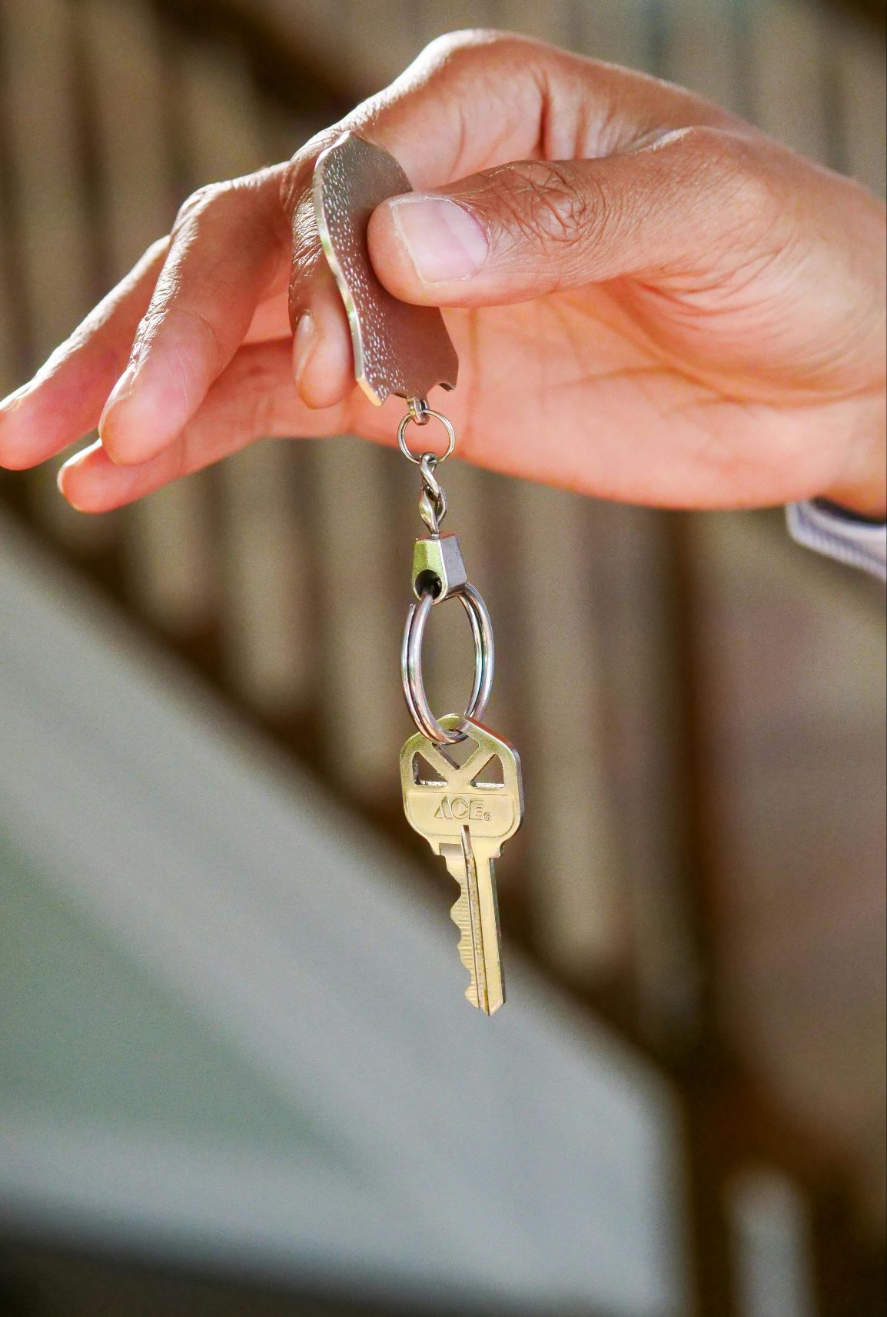
UrbanNest
House Rent Web Application

Slide 2

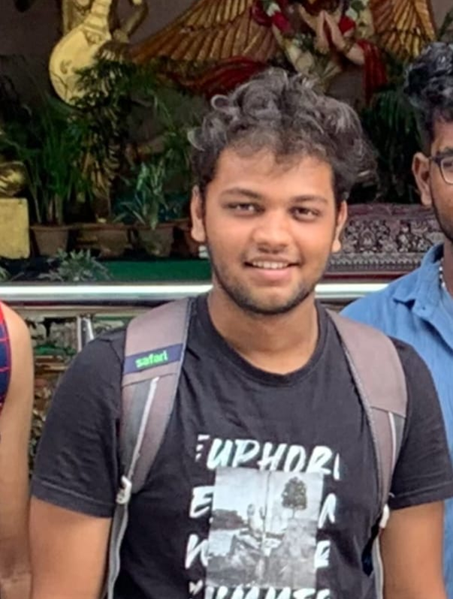


UrbanNest
Team Members
Surya V
Bhuvan R
Bhairav J Shah
Prateek Kumar H

Slide 3
UrbanNest
Objective :
The primary objective of our House Rent Web Application is to create a digital platform that simplifies and streamlines the process of finding and renting properties.
By providing a user-friendly interface and comprehensive property listings, Our web application aims to enhance the experience for both landlords and tenants.

Slide 4
UrbanNest
Abstract :
This project aims to develop a web application that streamlines the process of finding and renting houses.
The application will provide a user-friendly interface for tenants to search for available properties based on their preferences, such as location, budget, and amenities.
Landlords can easily list their properties, manage bookings, and communicate with potential tenants through the platform.

Slide 5
UrbanNest
Existing Systems
Challenges:
Mobile Responsiveness.
Limites Search Optimization.
Security Concerns.

Slide 6
UrbanNest
Existing Systems
Possible Solutions:
Mobile Application Development - By developing native apps for iOs and Android to improve accessibility and user experience.
Enhanced Search and Recommendations - By implementing AI/ML algorithms to suggest properties based on user preferences and browsing history.
Improved Security Measures - By using HTTPS for all connections, enforce secure password policies, and implement two-factor authentication(2FA).

Slide 7
UrbanNest
Proposed System
Overview:
The proposed House Rent Web Application is designed to revolutionize the traditional process of finding and renting properties. This innovative platform aims to streamline the entire rental process, making it more efficient and convenient for both landlords and tenants.
Key Features:
Comprehensive Property Listings:
A vast database of verified property listings, categorized by location, budget, and property type.
Advanced search and filter options to help users find their ideal property.
Detailed property information, including photos, videos, and virtual tours.

Slide 8
UrbanNest
2. User-Friendly Interface:
An intuitive and visually appealing interface, accessible from any device.
Easy navigation and seamless user experience.
Personalized recommendations based on user preferences and browsing history.
3. Landlord Dashboard:
A dedicated dashboard for landlords to manage their property listings, tenant inquiries, and rental agreements.
Real-time analytics and insights to optimize rental strategies.

Slide 9
UrbanNest
Front-end Architecture:Using React
The frontend of the Urban Nest Is built using React.js, a powerful library for creating dynamic and responsive user interfaces. It follows a component-based architecture to ensure reusability and maintainability.
Key Components and Features:
Component Hierarchy:
App Component: Acts as the root component and manages the routing for the entire application.
Dashboard Component: Displays a list of rental properties and provides filtering options.
Property Details Component: Shows detailed information about a selected property.
User Profile Component: Manages user-specific information such as bookings.
Admin Panel Component: Manages user-specific information such as bookings.
Owner Panel Component: Allows property owners to manage their listings.

Slide 10
UrbanNest
Routing: React Routers is used to manage routes for different user roles ( Renter, Owner, Admin ) and app features, ensuring smooth navigation.
UI Libraries:
Material UI and Ant Design (Antd): Enhance the UI with pre-built, responsive components.
Bootstrap: Provides additional styling flexibility.
State Management:
Context API or Redux (Optional): Used to manage global states such as user authentication and property data.
API Communication:
Axios: Handles API requests to interact with the backend, fetching or submitting data efficiently.

Slide 11
UrbanNest
Backend
Introduction
Objective: Develop a scalable backend for a house rental platform.
Core Features:
User Authentication
Property Listings
Search and Filter Functionality
Booking and Payments
Reviews and Ratings
Tech Stack: MongoDB, Express.js, Node.js.
Backend Architecture Overview
Architecture: RESTful API
Key Components:
Authentication & Authorization
Data Management (MongoDB)
API Gateway (Express.js)
Payment Integration
Cloud Deployment (e.g., AWS/Heroku)
Third-party Integrations: Stripe (Payments), Cloudinary (Image Uploads).

Slide 12
UrbanNest
Backend
Database Design
Collections:
Users:
Schema: {name, email, password, role (tenant/landlord), profilePicture}
Properties:
Schema: {title, description, location, price, landlordId, images, availability}
Bookings:
Schema: {propertyId, tenantId, startDate, endDate, status, paymentId}
Reviews:
Schema: {propertyId, userId, rating, comment}
Relationships:
Users ↔ Properties: One-to-Many
Properties ↔ Bookings: One-to-Many
Properties ↔ Reviews: One-to-Many

Slide 13
UrbanNest
Backend
Authentication & Authorization
Authentication:
Implemented using JWT (JSON Web Tokens).
Secure storage of tokens in HTTP-only cookies.
Authorization:
Role-based access control (Tenant vs. Landlord).
Example: Only landlords can create/edit properties.

Slide 14
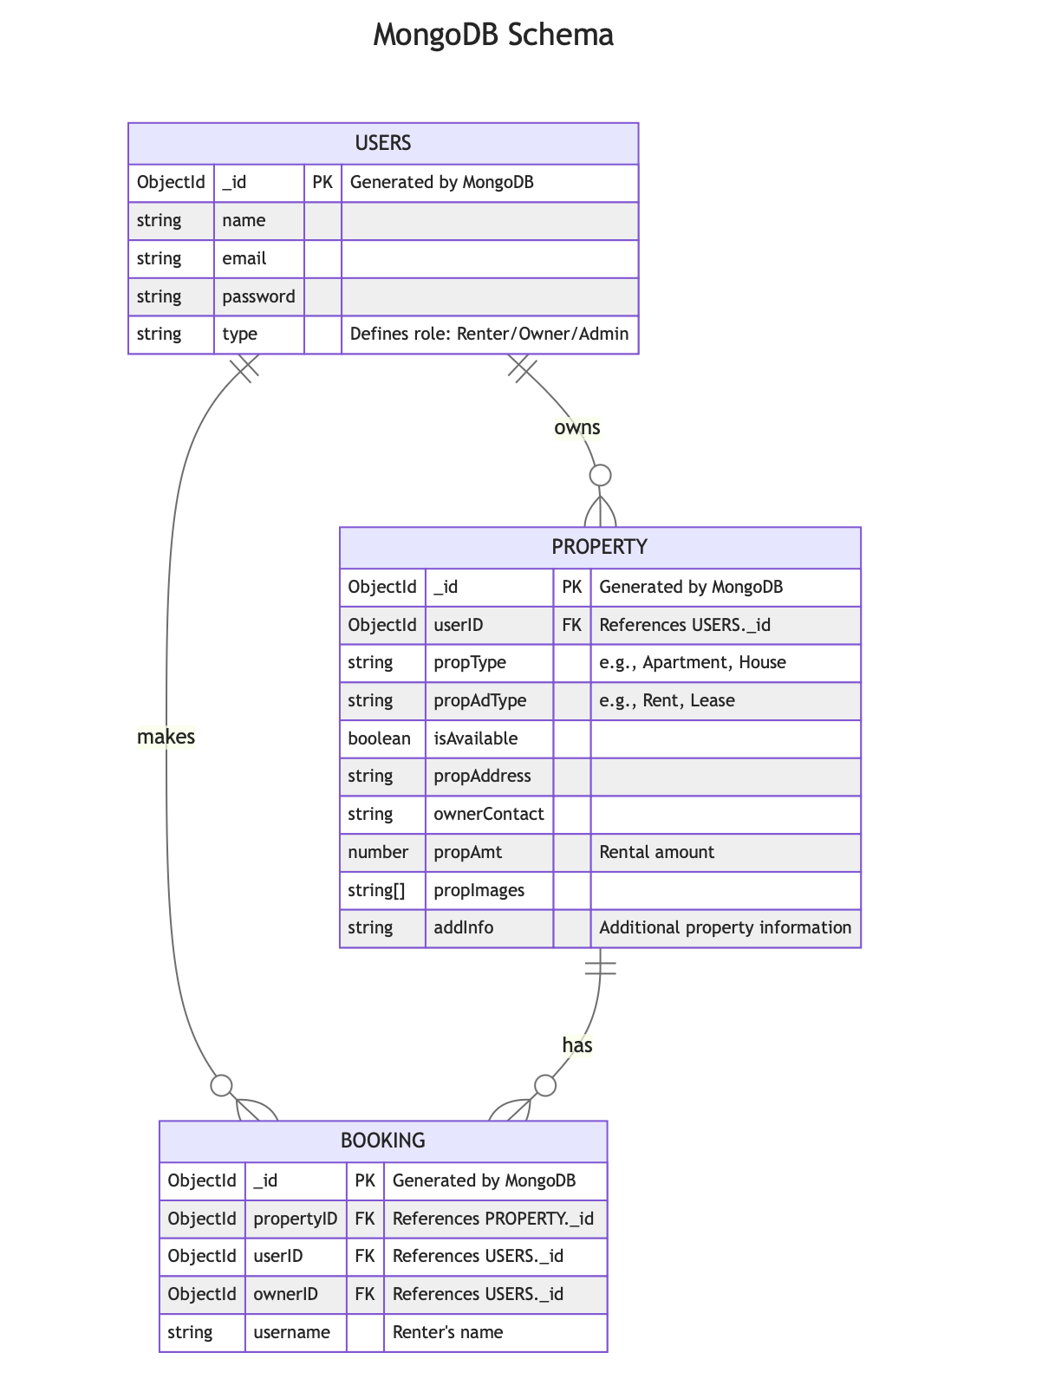
UrbanNest

Slide 15
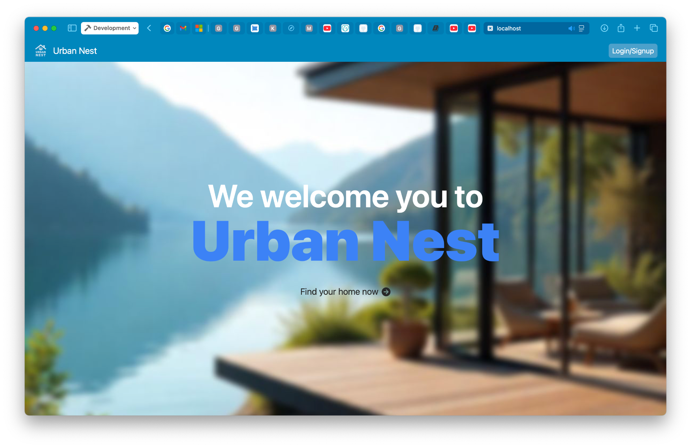
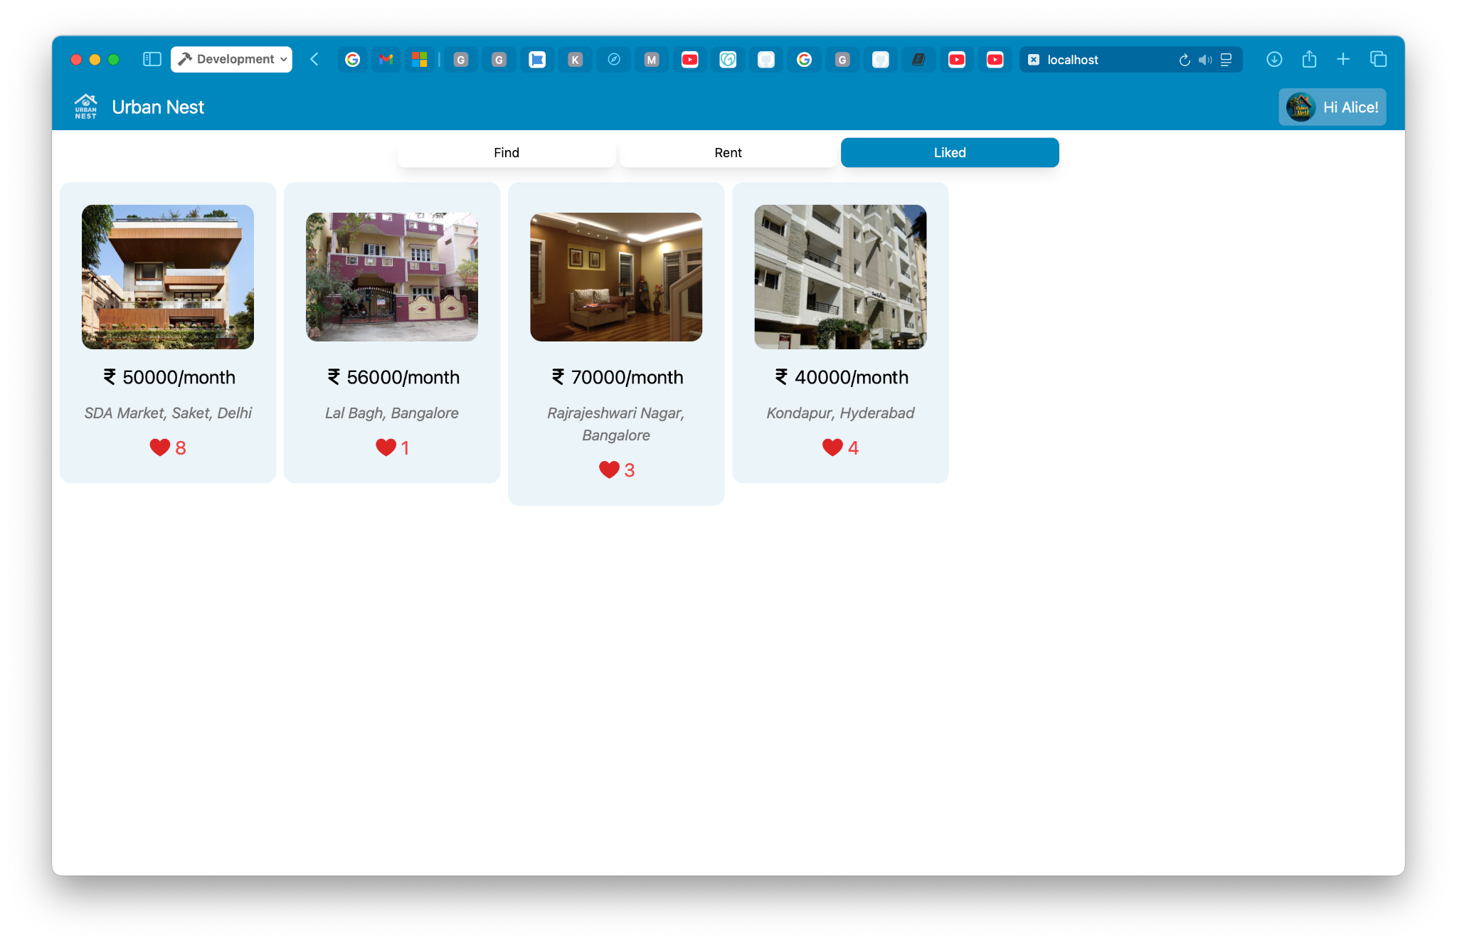
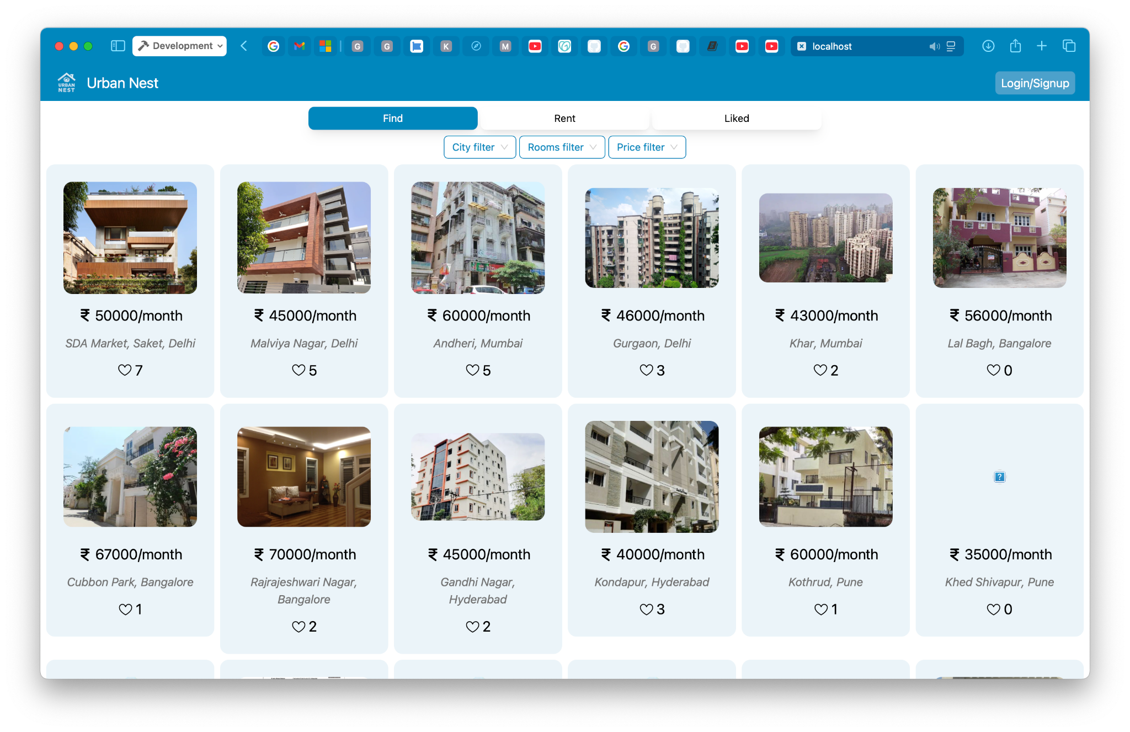
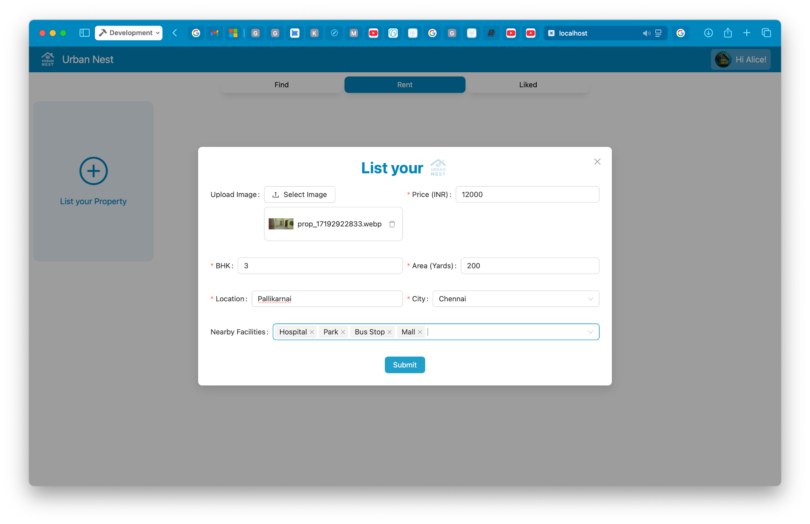
UrbanNest ScreenshotS

Slide 16
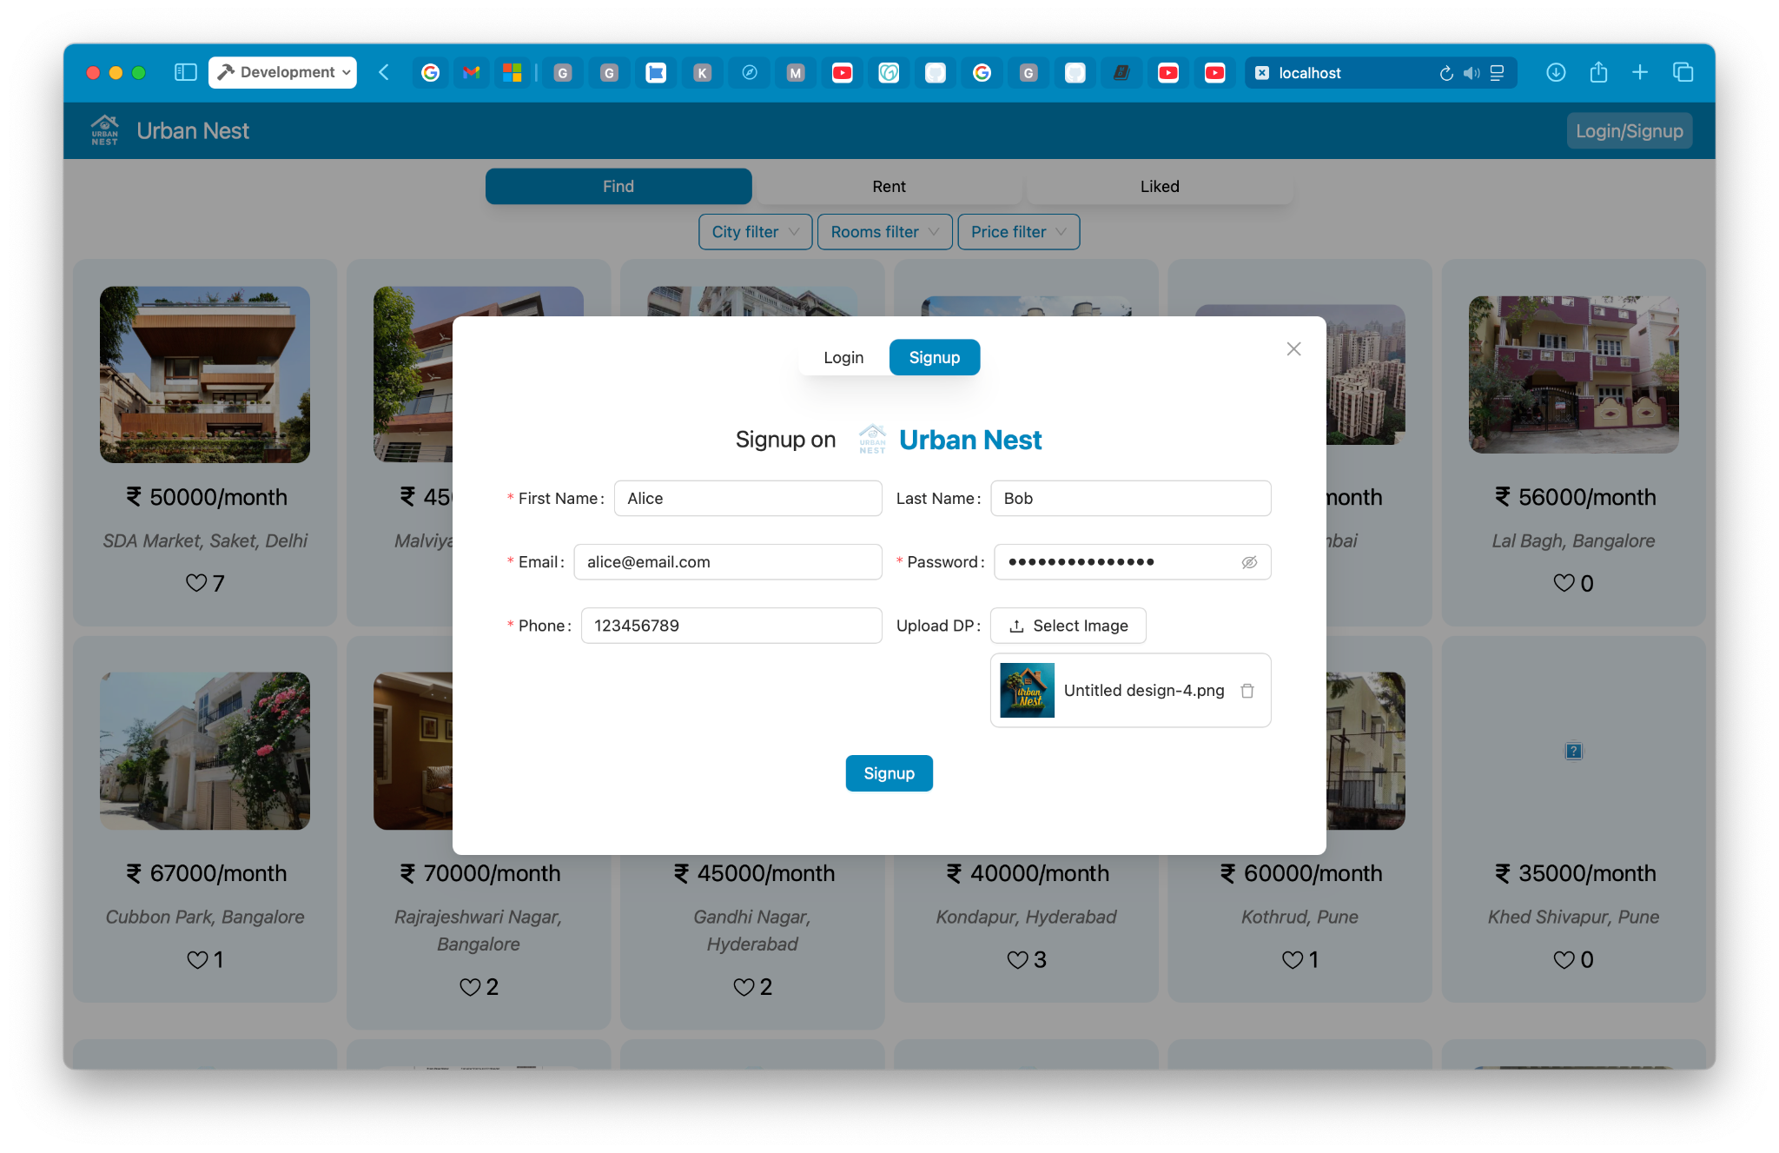
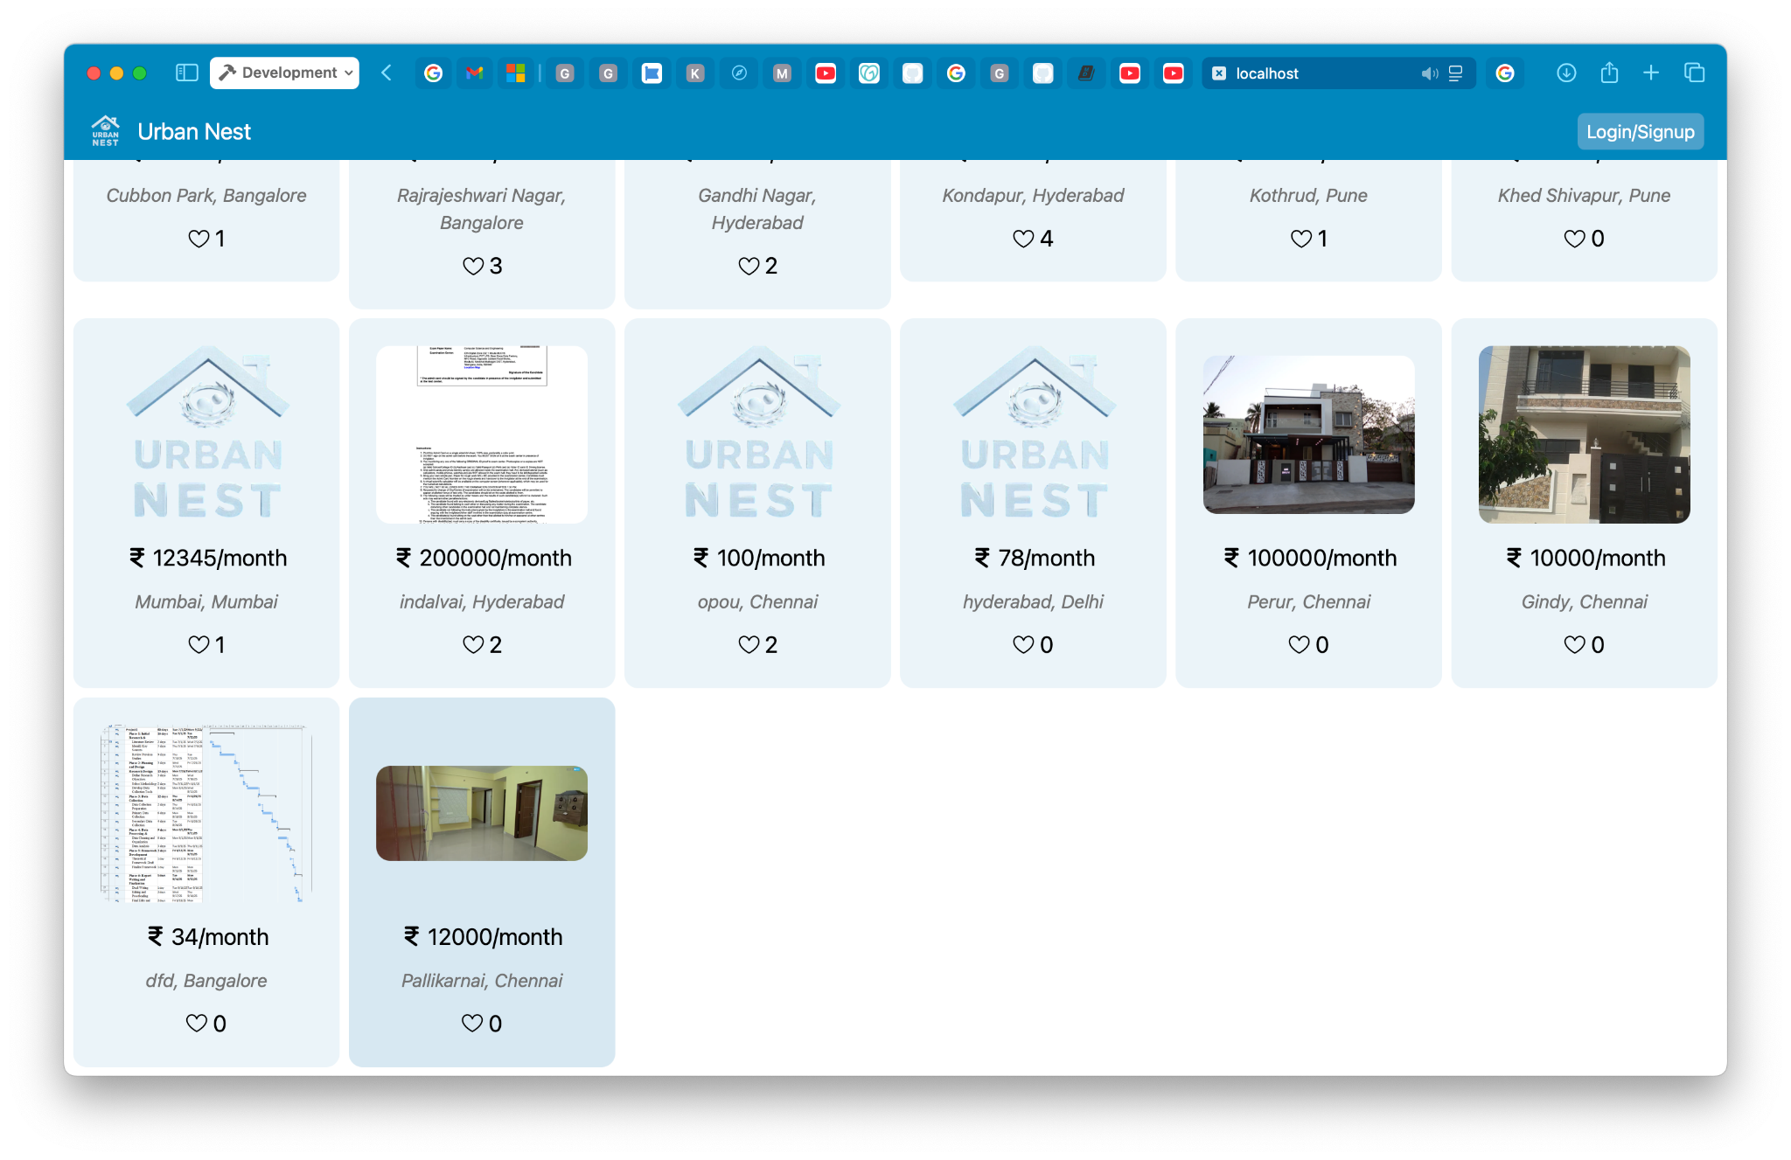
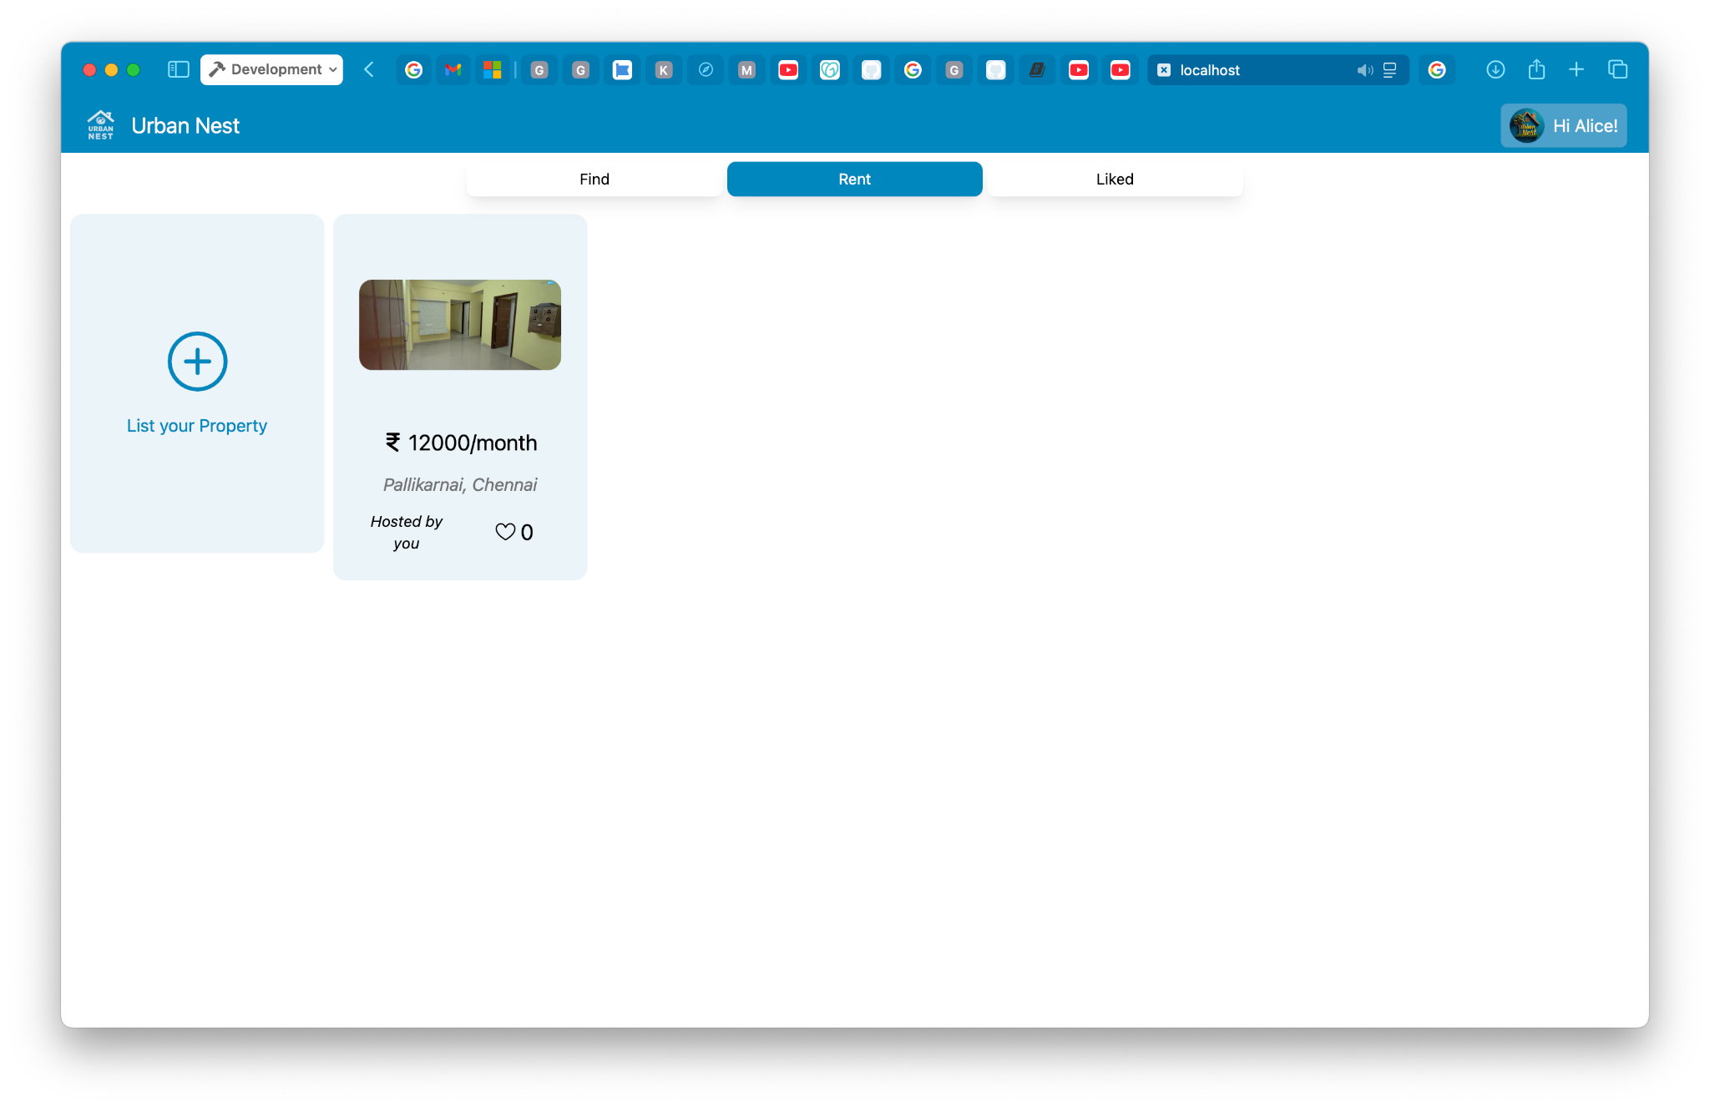
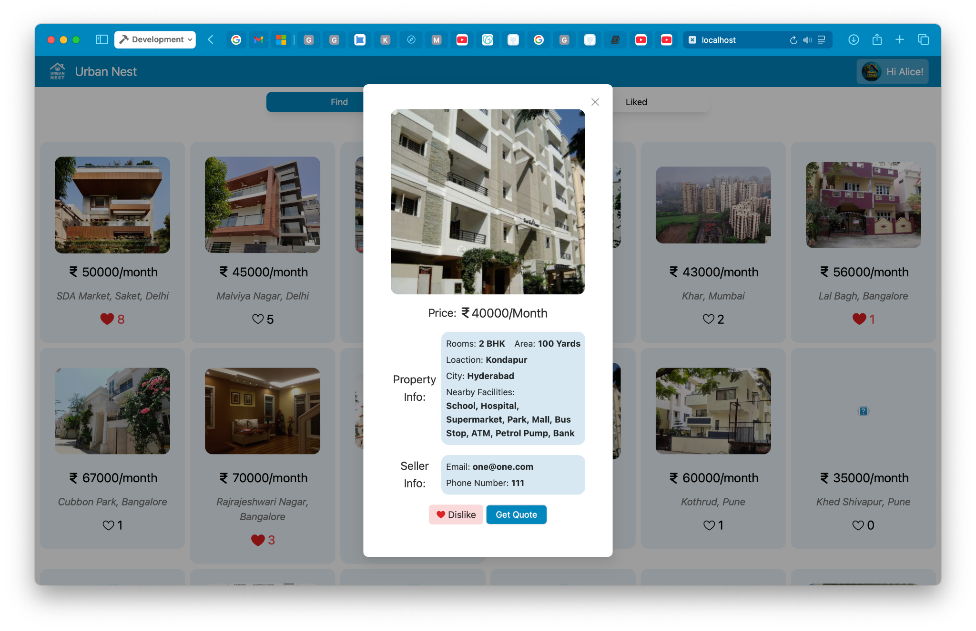
UrbanNest ScreenshotS

Slide 17
UrbanNest
Requirements
Software:
Node Package Manager/ Runtime
Tailwind Server
VScode or any editor with LSP support
MongoDB Community Server
Hardware:
An 64bit Arch, Linux or Unix Server with:
At least, dual core intel i5 processor or equivalent processor.
At least, 4 GB Unified/Un-unified primary memory(RAM).
At least, 10 GB RAID FS secondary memory storage.
At least, 2 Mbps Stable Internet connection with public IP access.
An I/O Device to interact with server i.e. an laptop with ssh

Slide 18
UrbanNest
Conclusion
In conclusion, UrbanNest exemplifies the potential of modern web technologies in creating efficient, user-friendly solutions for everyday challenges. As a comprehensive marketplace for renters and tenants in major Indian cities, it simplifies property transactions by bridging the gap between property owners and prospective tenants. Developed using the robust MERN stack and enhanced by tools like Tailwind CSS, Ant Design, Cloudinary, and EmailJS, UrbanNest provides a seamless experience for users to list, browse, and manage properties. Its deployment on Vercel ensures accessibility, while its open-source nature invites continuous learning and contributions. UrbanNest is a step toward making property rentals more streamlined and accessible.

